Slide 1
Technical English for Computer Science
Week 3
Dr. Nur Banu OĞUR

Slide 2
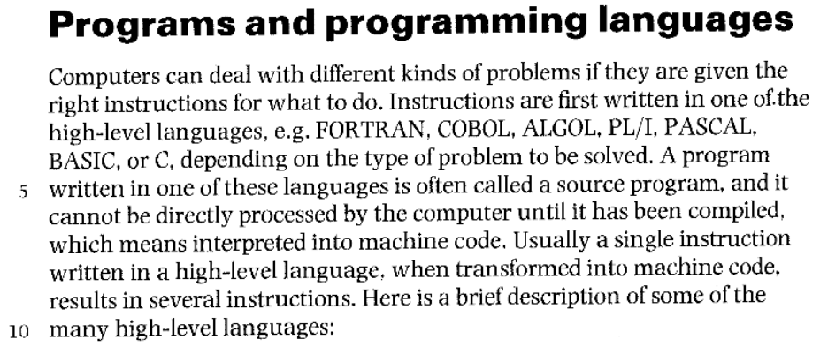

Slide 3
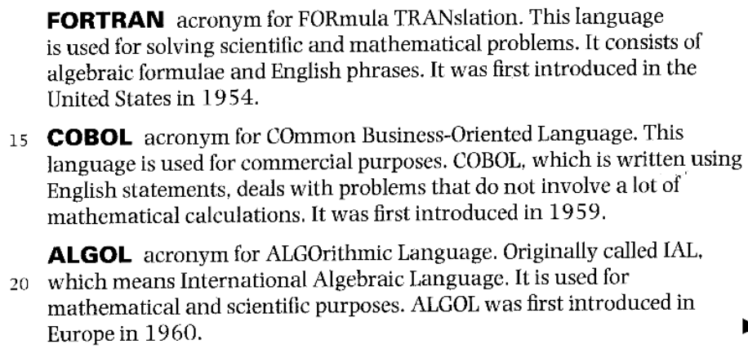

Slide 4
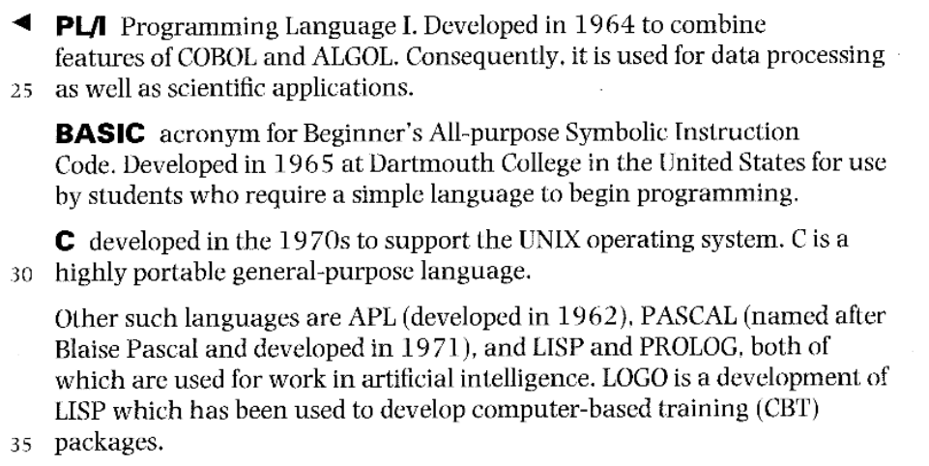

Slide 5
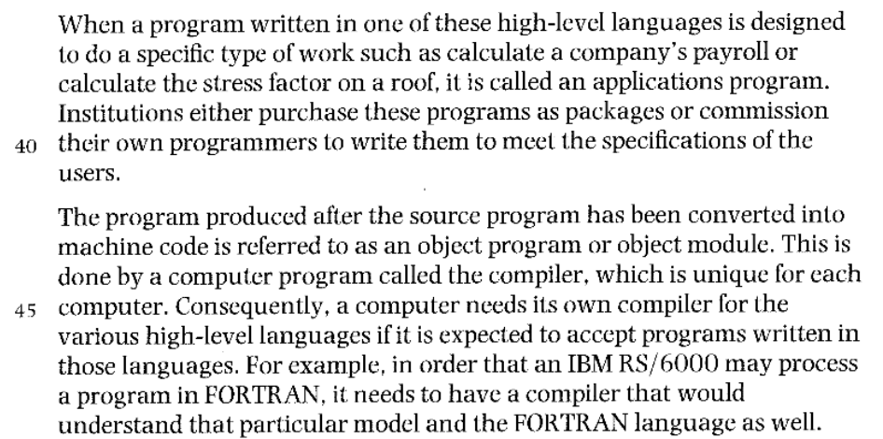

Slide 6
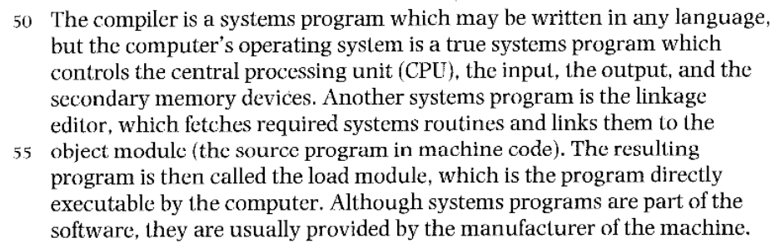

Slide 7
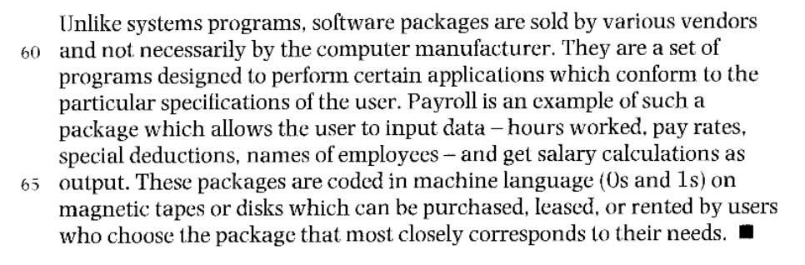

Slide 8
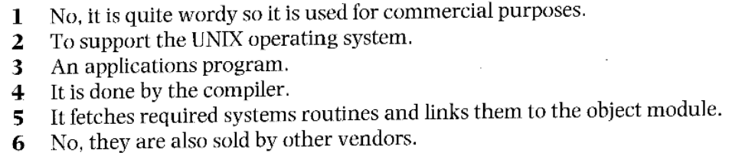
These are answers the questions about the text. Write their questions.

Slide 9
1. Is cobol used for scientific purposes?
2. Why was C developed in the 19 70s?
3. What do you call a program written in a highlevel language designed to perform a specific task?
4. Which part of the systems software converts the source code to machine code?
5. What does the linkage editor do?
6. Are software packages only sold by the hardware manufacturer?

Slide 10
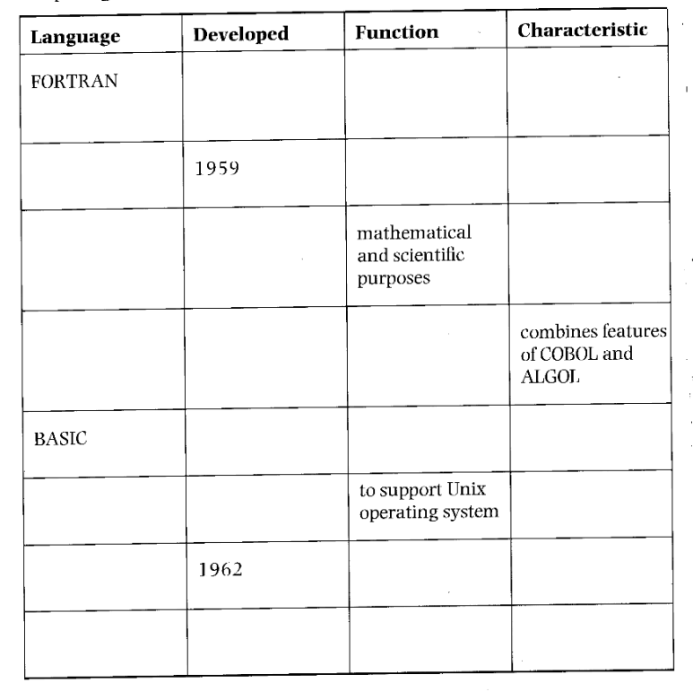
Summarize the information on different high-level computer languages by completing the table below.

Slide 11
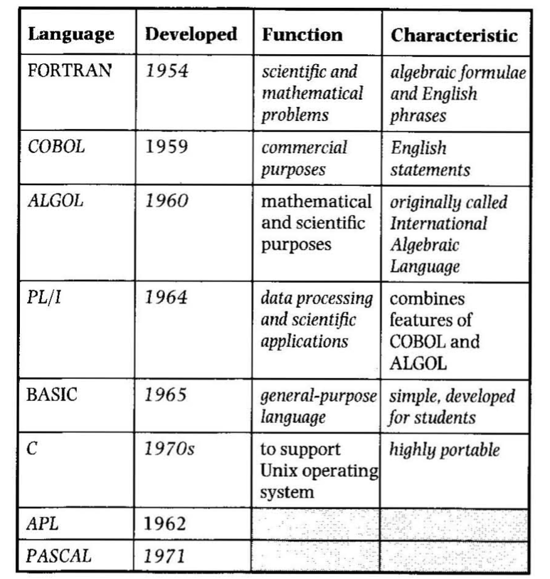

Slide 12
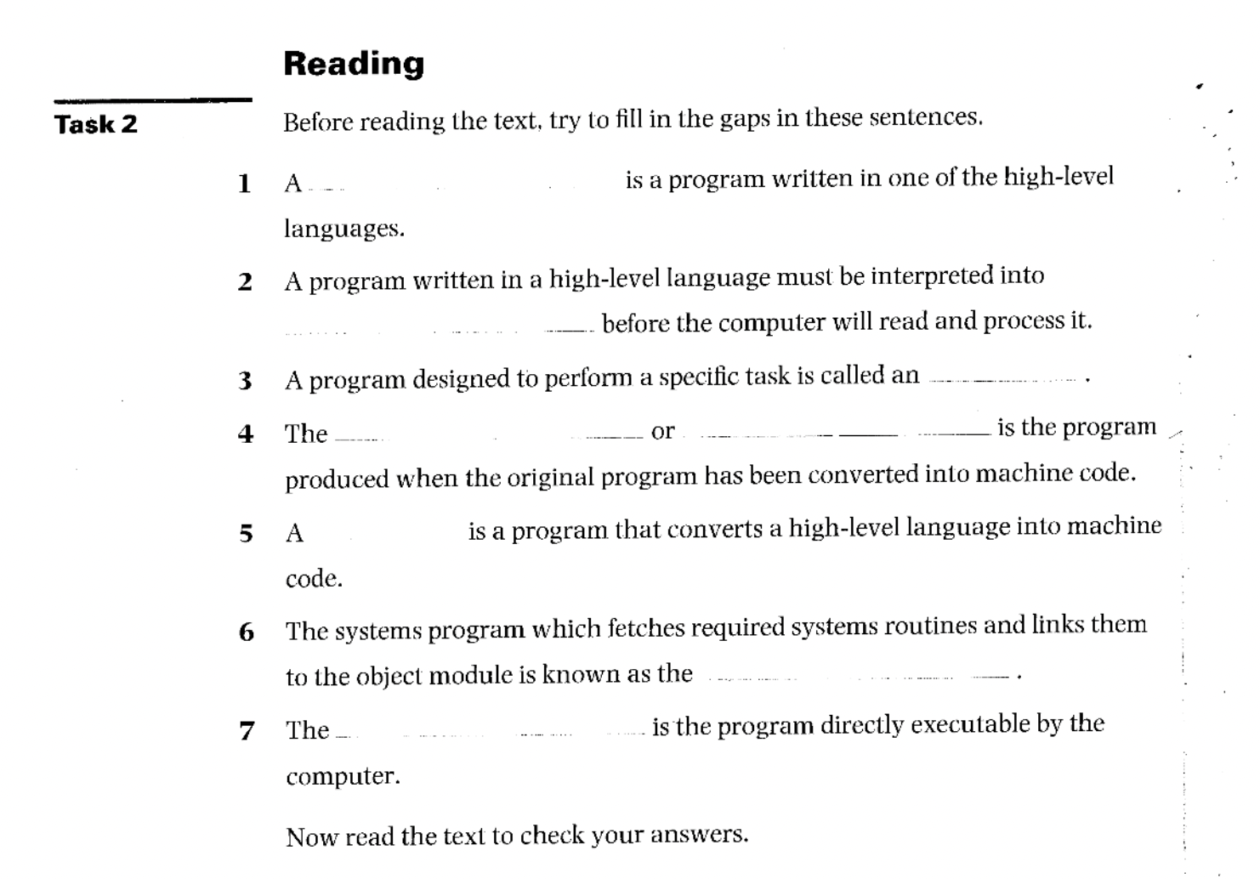

Slide 13
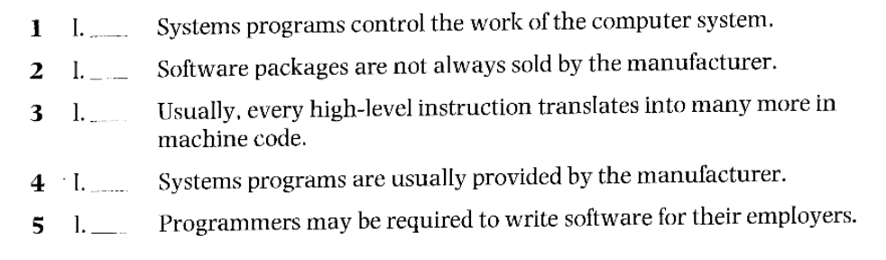
Find the passages in the text where the following ideas are expressed. Give the line references.

Slide 14
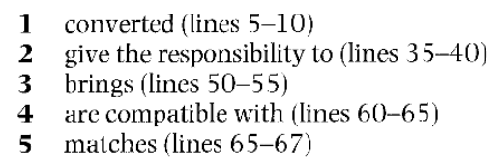
Using the line references given, refer back to the text and find words or phrases that have a similar meanings to:

Slide 15
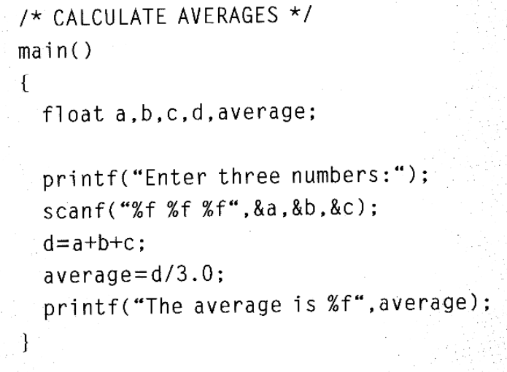
Read the program and text, then complete the sentences.

Slide 16
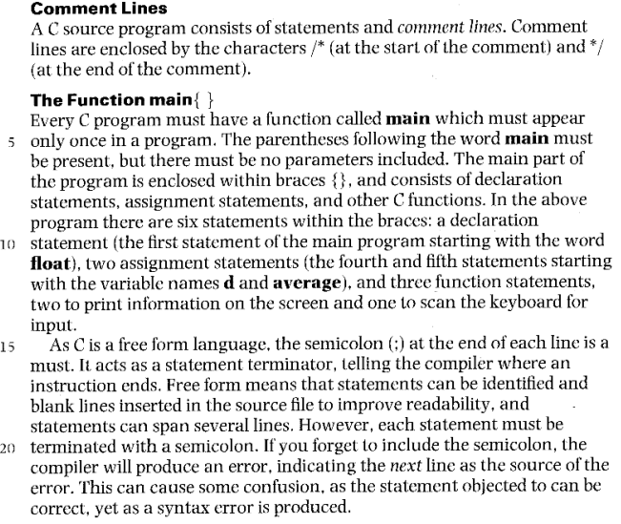

Slide 17
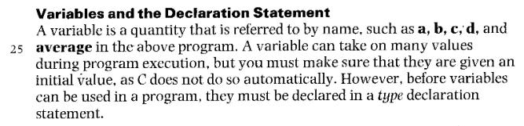

Slide 18
